Slide 1

Addressing E-commerce Challenges with Data Analysis

Slide 2
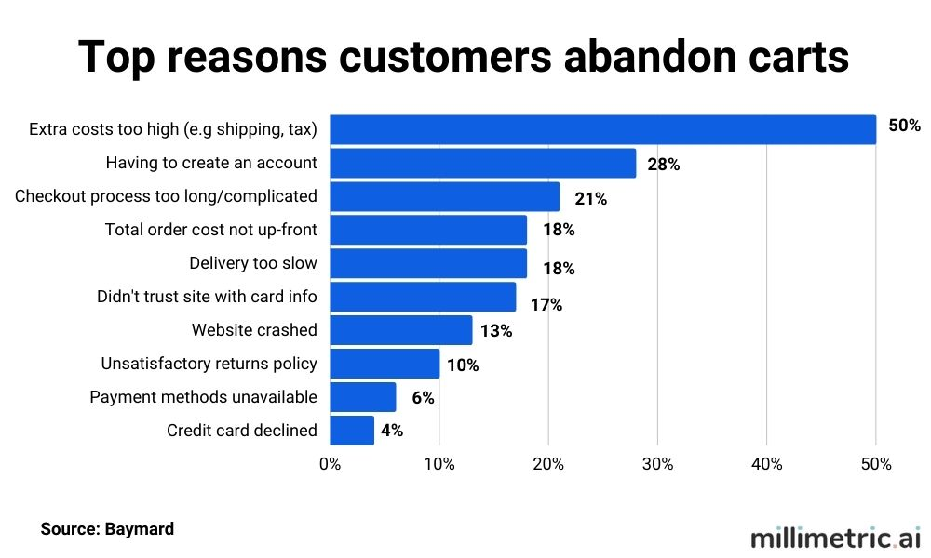
Introduction
The e-commerce landscape is rapidly evolving, with consumers increasingly shifting towards online shopping.
While this presents exciting opportunities for businesses, it also comes with its own set of challenges. Today, we're here to explore how our e-commerce business is taking on these challenges head-on and leveraging the power of data analysis to stay competitive and relevant
Our e-commerce business has been experiencing some significant hurdles that demand our immediate attention:

Slide 3
Team Contributions
Kushsal Reddy: Conducted data preprocessing, built and optimized the predictive model, and provided insights into customer behavior.
Gopi Chand Yenikapalli: Managed data acquisition, storage, and the data pipeline, ensuring clean and available data for analysis and feature engineering and identified performance parameter.
Manasa Swetha Tiramareddy : Defined project objectives, conducted market research, and collaborated on data-driven strategies to address e-commerce challenges.
Manoj Arasada: Conducted exploratory data analysis, assisted with feature selection, prepared data visualizations, and ensured data analysis aligned with business objectives and model evaluation

Slide 4
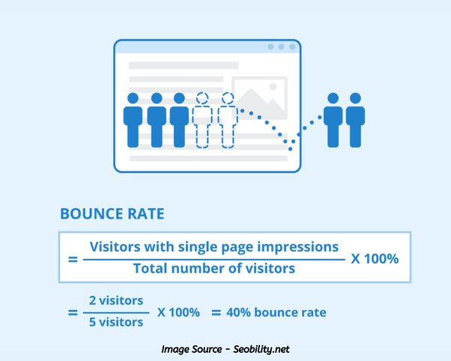
Business Challenges
Our e-commerce business is currently grappling with several pressing challenges that directly impact our performance:
Declining Customer Engagement: We've observed a continuous decline in customer engagement metrics, indicating potential issues with user interaction.
Increasing Bounce Rates: Bounce rates have been on the rise, suggesting that visitors are leaving our site without exploring further.
Decreasing Revenue: These challenges have contributed to decreasing revenues, highlighting the urgency of addressing these issues.
These challenges are not just numbers; they impact our business's sustainability. Identifying and addressing the underlying causes is crucial to reverse these negative trends and maintain a competitive edge.

Slide 5

How Data Analysis/Modeling Can Address the Challenge
Data analysis and predictive modeling offer powerful tools to understand, tackle, and overcome our current business challenges. Here's how they can play a pivotal role:
Understanding Customer Behavior: Data analysis allows us to gain deep insights into how customers interact with our platform. We can identify what leads to engagement and conversion or, conversely, what causes visitors to leave.
Predictive Models for Customer Intent: By utilizing predictive models, we can forecast customer intent. These models can help us identify the likelihood of a visitor making a purchase based on their interactions with our platform.
Personalized Interventions: Armed with data-driven insights, we can make targeted interventions, optimizing website design, content, and marketing strategies to enhance the customer experience and encourage conversions

Slide 6

Data Description
The dataset captures the essence of online shopping, a significant segment of the B2C (Business to Customer) market. Understanding the patterns of online shoppers in terms of their research and purchasing habits is vital for businesses. Insights into these behaviors can guide targeted marketing strategies and promotional activities to enhance sales and overall revenue.
TARGET VARIABLES
- Revenue: Indicates whether a purchase was completed.
PREDICTOR VARIABLES
- Administrative: Counts of administrative page visits by the user.
- Administrative_Duration: Time spent on administrative pages.
- Informational: Counts of informational page visits by the user.
- Informational_Duration: Time spent on informational pages.
- ProductRelated: Counts of product-related page visits by the user.
- ProductRelated_Duration: Time spent on product-related pages…etc

Slide 7
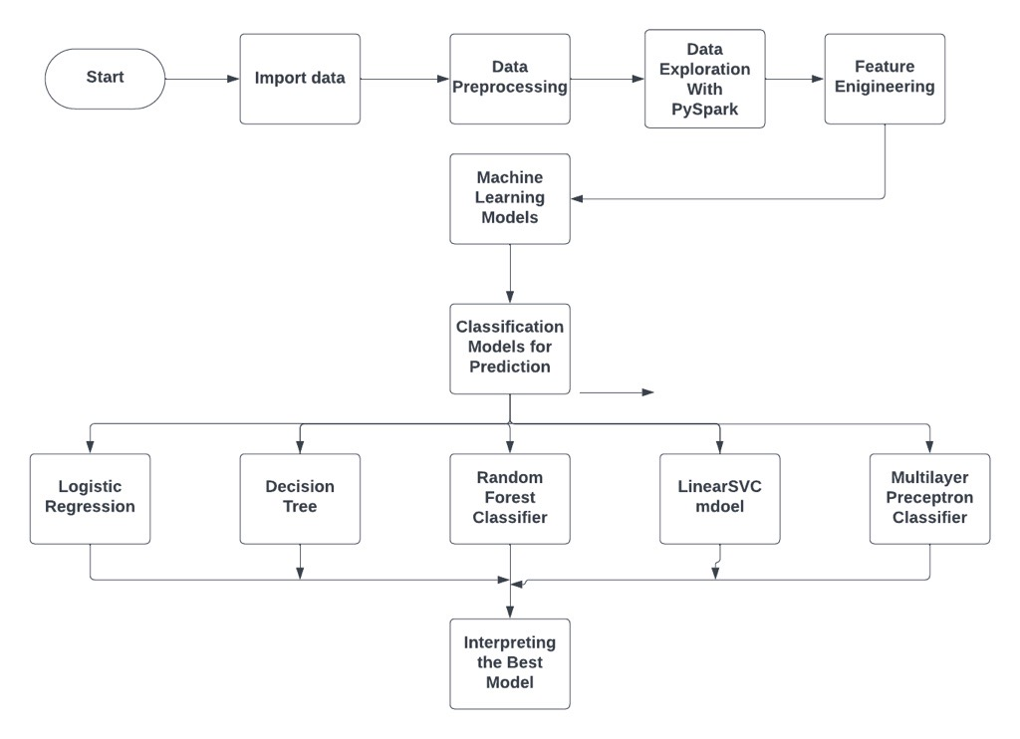
DATA FLOW DIAGRAM

Slide 8
MODELS SELECTED
Logistic Regression
Decision Tree
Random Forest
Linear SVC
Multilayer Perceptron Classifier

Slide 9
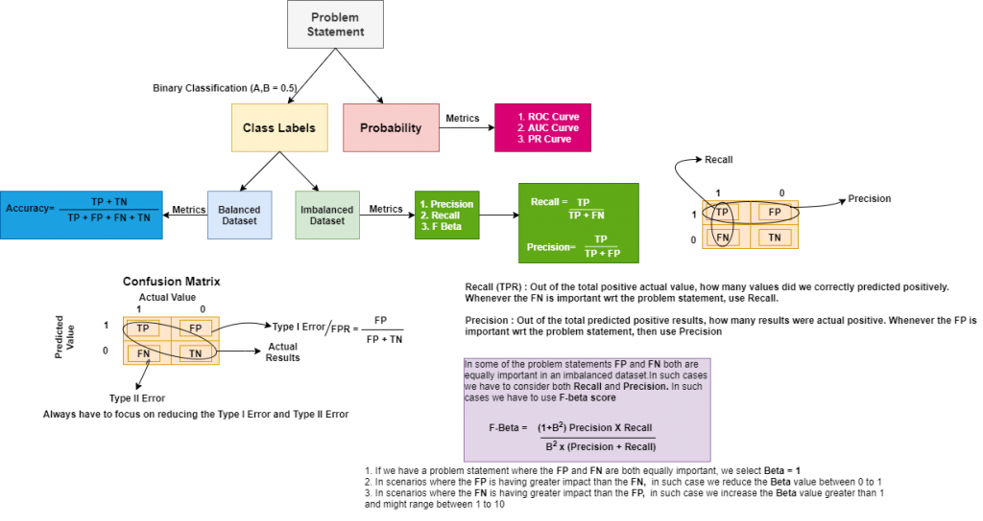
Evaluating Metrics

Slide 10
Comparing the F1 And AUC Score of Various Models

Slide 11

Data Challenges
Data Quality
Challenge: The dataset contained outliers, and inconsistencies.
Overcoming: Rigorous data cleaning and preprocessing were performed to ensure data quality.
Feature Selection
Challenge: Selecting relevant features from a wide range of options.
Overcoming: Feature selection methods were employed to choose the most informative variables.
Imbalanced Data
Challenge: Imbalance between successful purchases (1) and non-purchases (0) in the dataset.
Overcoming: Class balancing strategies, such as oversampling applied.

Slide 12
Business Conclusion
The analysis reveals that implementing a Random Forest for predictive analytics in our e-commerce platform is the most effective strategy. This model's superior F1 score, and AUC will allow us to accurately predict and enhance customer purchase intentions.
Adopting this model will enable targeted marketing strategies, optimize customer interactions, and potentially reduce bounce rates, thereby increasing customer engagement and revenue. The integration of this model into our business processes, complemented by a responsive data feedback system, is essential for adapting to consumer trends and securing a competitive advantage in the rapidly evolving e-commerce landscape.

